Slide 1
Introduction to Text Analytics
Basic Concepts and Processes

Slide 2
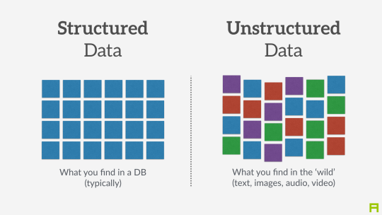
Why Text Analytics?
Much of our data is unstructured

Slide 3
What is a Corpus?
In the context of NLP, a corpus is:
A body of text
Usually comprising multiple documents
All in a single language
Examples include
Reviews for a particular product on Amazon
Reviews for a particular restaurant on Yelp
Facebook posts from a single organization
Abstracts from a collection of books or articles

Slide 4
Corpus Structure
You must be able to differentiate items in a corpus
Lines of text in a large document
Separate documents in a folder
Document data in a NoSQL database
Use Corpus reader depending on how data is formatted:
https://docs.huihoo.com/nltk/0.9.5/api/nltk.corpus.reader-module.html
We will keep it simple with the PlaintextCorpusReader
# Note: Corpus files must be placed in a subfolder called 'corpdir'
# This subfolder should be inside whichever folder the code is running
reviews = PlaintextCorpusReader('corpdir/','.*')

Slide 5

How Do We Make Sense of Text?
Entity Extraction
Stopword Filtering
Stemming
Similarity metrics
Dominant Word Metrics
Sentiment Analysis

Slide 6
Entity Extraction
Identify and classify entities in text
The quick brown fox jumped over the lazy dog
Now is the winter of our discontent made glorious summer by this Son of York
Luke, I am your father

Slide 7
Entity Extraction
Identify and classify entities in text
The quick brown fox jumped over the lazy dog
Now is the winter of our discontent made glorious summer by this Son of York
Luke, I am your father

Slide 8
Stopword Filtering
Eliminates insignificant words from the text
The quick brown fox jumped over the lazy dog
Now is the winter of our discontent made glorious summer by this Son of York
Luke, I am your father

Slide 9
Stopword Filtering
Eliminates insignificant words from the text
The quick brown fox jumped over the lazy dog
Now is the winter of our discontent made glorious summer by this Son of York
Luke, I am your father

Slide 10
Stemming
Converting a word to its root
The quick brown fox jumped over the lazy dog
Now is the winter of our discontent made glorious summer by this Son of York
Luke, I am your father

Slide 11
Stemming
Converting a word to its root
The quick brown fox jump over the lazy dog
Now is the winter of our discontent made glori summer by this Son of York
Luke, I am your father

Slide 12
Text Similarity
How similar are blocks of text
Can be used to identify similar concepts
Common for plagiarism detector systems
Easy to code in R or Python
Here is an example in Python:
https://towardsdatascience.com/overview-of-text-similarity-metrics-3397c4601f50

Slide 13


Dominant Word Metrics
What are the words that are most common in a block of text?
Term Frequency
Are these concepts or themes also common in other texts or are they unique?
Inverse document frequency
Put these concepts together:
tf-idf

Slide 14
Sentiment Analysis
Looking for emotional intensity
Some words have positive or negative emotional contexts
Look for these words
Look for intensifiers
Look for negations
Variations
Stock Trading – Bull vs Bear

Slide 15
Setup NLTK
Run Python Prompt Terminal as administrator
Install scipy and NLTK:
python –m pip install –user scipy
pip install nltk
python -m nltk.downloader all

Slide 16
Remove Punctuation
Easiest way to remove punctuation is through regular expressions
import re
strGB = re.sub("[^\w\s]", "", strGB)

Slide 17
Set to Lower Case
Since we care about words and not sentence structures, upper case probably means very little to us.
String variables can be converted using a ‘lower()’ function
This code will change the string to lower case and store it back into the same variable
strGB = strGB.lower()

Slide 18
Tokenize
We will be using a word-based tokenizer
This is just one of many options. You can see your book for more.
A tokenizer will return a list of tokens. The code below stored this list into a variable called ‘words’
words = word_tokenize(strGB)

Slide 19
Remove Stopwords
Stopwords are small words that usually add little meaning to the text.
Use this code to print a list of English stopwords if you are interested in seeing it:
from nltk.corpus import stopwords print(stopwords.words(‘english’))
Use this code to remove stopwords from the list:
from nltk.corpus import stopwords
eng_stop = set(stopwords.words('english'))
words_nostop = [word for word in words if word not in eng_stop]

Slide 20
Stem the List
Stemmer reduce words to a common stem.
There are many stemmers including
Porter
Lancaster
Snowball
The following code will stem a list and create a new resulting list using the Porter stemmer
from nltk.stem import PorterStemmer
stemmer = PorterStemmer()
words_stem = []
for word in words_nostop:
words_stem.append(stemmer.stem(word))

Slide 21

Demos
Demo 1: Simple Example using a single file
Demo 2: Corpus example with multiple files

